Slide 1
Secure Data Hiding In Images Using Steganography
CAPSTONE PROJECT
Presented By: Rishabh Kumar
Student Name: Rishabh Kumar
College Name: MVJ College of Engineering
Department : Computer Science and Engineering

Slide 2
OUTLINE
Problem Statement
Technology used
Wow factor
End users
Result
Conclusion
Git-hub Link
Future scope

Slide 3
Problem Statement
Traditional encryption methods are easily detectable and may raise suspicion, creating a need for a more secure way to hide confidential messages within images. It is essential to ensure data security while maintaining the integrity of the cover image. Additionally, making encryption and decryption accessible to non-technical users through a simple interface can enhance usability and broaden its application.

Slide 4
Technology used
Programming Language: Python
Image Processing Library: OpenCV
File Handling & Security: Basic encryption logic for password protection
UTF-8 Encoding – Converts messages into byte format for embedding within image pixels
Platform: Windows 11

Slide 5
Wow factors
Uses steganography to embed a message into an image without noticeable changes.
Lossless data hiding using pixel value manipulation instead of traditional cryptographic techniques.
Works on any standard image file format (PNG recommended for best results).
Lightweight & Fast – Uses simple byte-level encoding, making encryption and decryption incredibly quick and efficient without requiring complex cryptographic algorithms.

Slide 6
End users
Cybersecurity Enthusiasts – Exploring secure communication techniques.
Government & Defense – Secure message transmission without raising suspicion.
Journalists & Activists – Concealing sensitive information in images to avoid surveillance.
Software Developers – Learning steganography concepts and their applications.

Slide 7
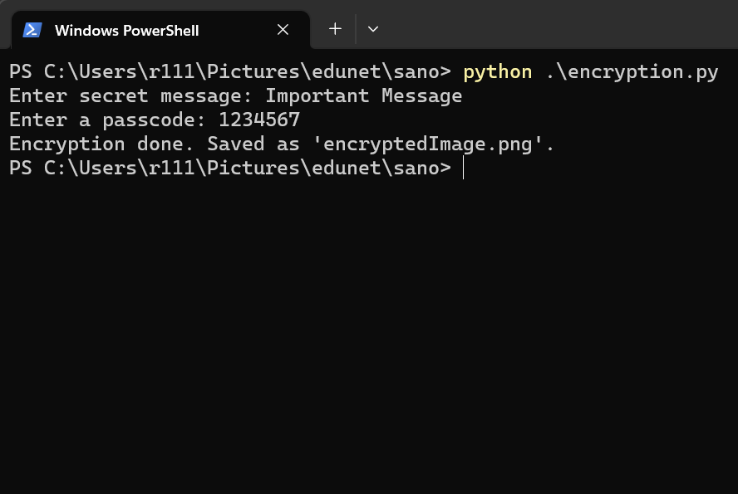
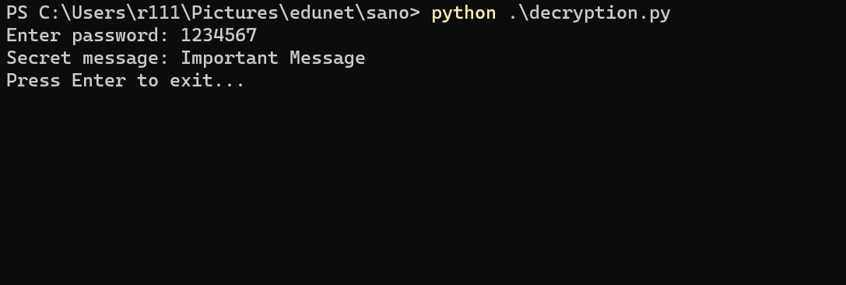
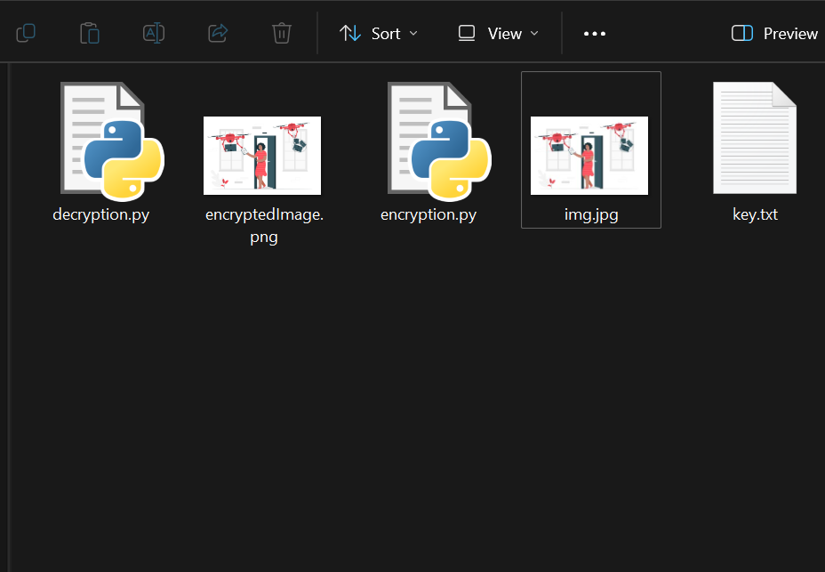

Results
Encryption:
Decryption :
File System:
Input Image File:
Output Image With Secret Message:

Slide 8
Conclusion
This steganography-based encryption method provides a secure and undetectable way to hide confidential messages within images while preserving their visual integrity. By integrating password protection, it ensures that only authorized users can retrieve the hidden message. The implementation is lightweight, fast, and user-friendly, making encryption and decryption accessible even to non-technical users. With its minimal impact on image quality and cross-platform compatibility, this approach serves as an effective and practical solution for secure communication.

Slide 9
GitHub Link
https://github.com/rishabhkr-r111/image-based-steganography.git

Slide 10
Future scope
Advanced Encryption Techniques – Integrate AES encryption before embedding text in images.
Support for Audio & Video Steganography – Expanding beyond images.
AI-based Detection Prevention – Ensuring messages stay undetectable from modern forensic tools.
Mobile App & Web Version – Expanding accessibility beyond desktops.

Slide 11
THANK YOU

